Slide 1
Machine Learning
Lesson 1

Slide 2
Content:
What is machine learning
What machine learning can do
Roadmap of machine learning
Setup development environment
Simple linear regression example

Slide 3

Machine Learning is…
Machine learning, a branch of artificial intelligence, concerns the construction and study of systems that can learn from data.

Slide 4
Machine Learning is…
Machine learning is about predicting the future based on the past.
-- Hal Daume
past
future
predict
learn
Training
Data
model/
predictor
Testing
Data
model/
predictor

Slide 5

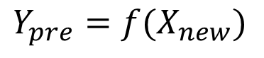
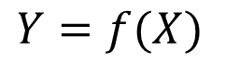
What is machine learning
Given input X, you have output Y
Look for a function f that generate Y out
of X
$$Y=f(X)$$
Use f to do prediction on new input X
$$Y_{pre}=f(X_{new})$$
https://www.youtube.com/watch?v=IpGxLWOIZy4

Slide 6

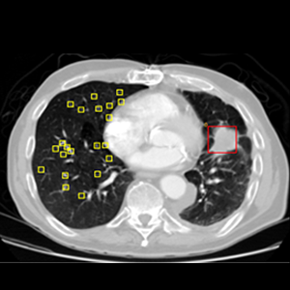
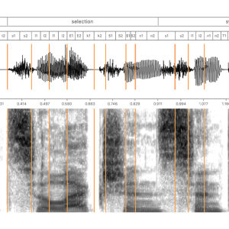
What machine learning can do
https://medium.mybridge.co/learn-to-build-a-machine-learning-application-from-top-articles-of-2017-cdd5638453fc
Notes:
1 HealthCare: McKinsey Global Institute estimates that applying machine learning techniques to better inform decision making could generate up to $100 billion in value based on optimized innovation, enhanced efficiency of clinical trials and the creation of various novel tools for physicians, insurers and consumers.
2. Finance: More than 90% of the top 50 financial institutions around the world are using machine learning and advanced analytics. One of the core machine learning use cases in banking/finance domain is to combat fraud.
3. Retail: According to The Realities of Online Personalisation Report, 42% of retailers are using personalized product recommendations using machine learning technology.
4.

Slide 7
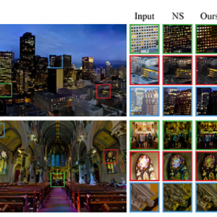
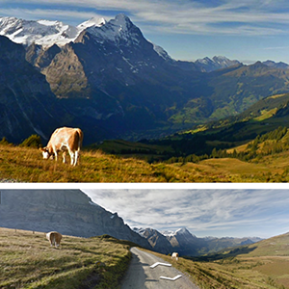
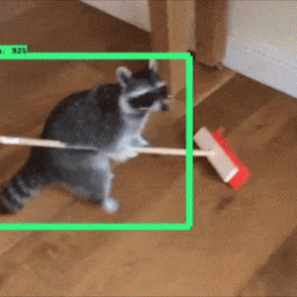
What machine learning can do
https://medium.mybridge.co/learn-to-build-a-machine-learning-application-from-top-articles-of-2017-cdd5638453fc
Notes:
1 HealthCare: McKinsey Global Institute estimates that applying machine learning techniques to better inform decision making could generate up to $100 billion in value based on optimized innovation, enhanced efficiency of clinical trials and the creation of various novel tools for physicians, insurers and consumers.
2. Finance: More than 90% of the top 50 financial institutions around the world are using machine learning and advanced analytics. One of the core machine learning use cases in banking/finance domain is to combat fraud.
3. Retail: According to The Realities of Online Personalisation Report, 42% of retailers are using personalized product recommendations using machine learning technology.
4.

Slide 8
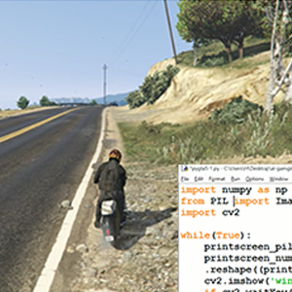
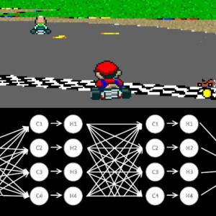

What machine learning can do
https://medium.mybridge.co/learn-to-build-a-machine-learning-application-from-top-articles-of-2017-cdd5638453fc
Notes:
1 HealthCare: McKinsey Global Institute estimates that applying machine learning techniques to better inform decision making could generate up to $100 billion in value based on optimized innovation, enhanced efficiency of clinical trials and the creation of various novel tools for physicians, insurers and consumers.
2. Finance: More than 90% of the top 50 financial institutions around the world are using machine learning and advanced analytics. One of the core machine learning use cases in banking/finance domain is to combat fraud.
3. Retail: According to The Realities of Online Personalisation Report, 42% of retailers are using personalized product recommendations using machine learning technology.
4.

Slide 9
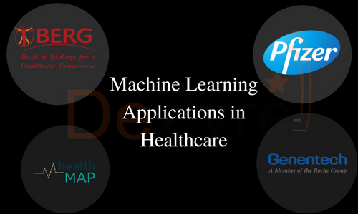
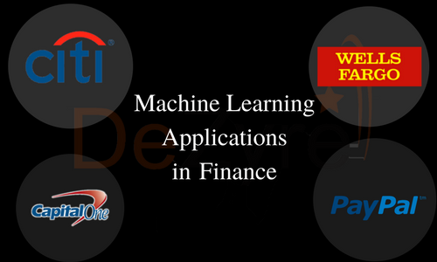
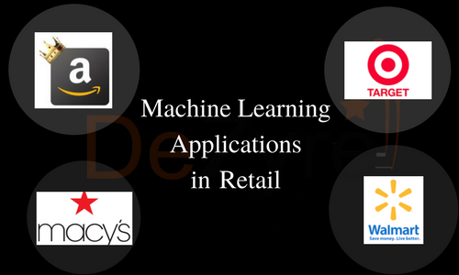
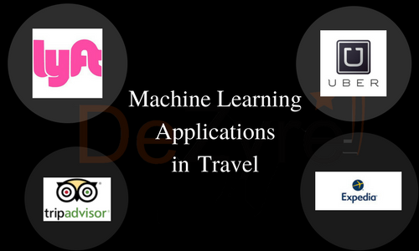
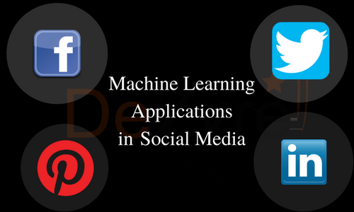
What machine learning can do
https://www.dezyre.com/article/top-10-industrial-applications-of-machine-learning/364
Notes:
1 HealthCare: McKinsey Global Institute estimates that applying machine learning techniques to better inform decision making could generate up to $100 billion in value based on optimized innovation, enhanced efficiency of clinical trials and the creation of various novel tools for physicians, insurers and consumers.
2. Finance: More than 90% of the top 50 financial institutions around the world are using machine learning and advanced analytics. One of the core machine learning use cases in banking/finance domain is to combat fraud.
3. Retail: According to The Realities of Online Personalisation Report, 42% of retailers are using personalized product recommendations using machine learning technology.
4.

Slide 10
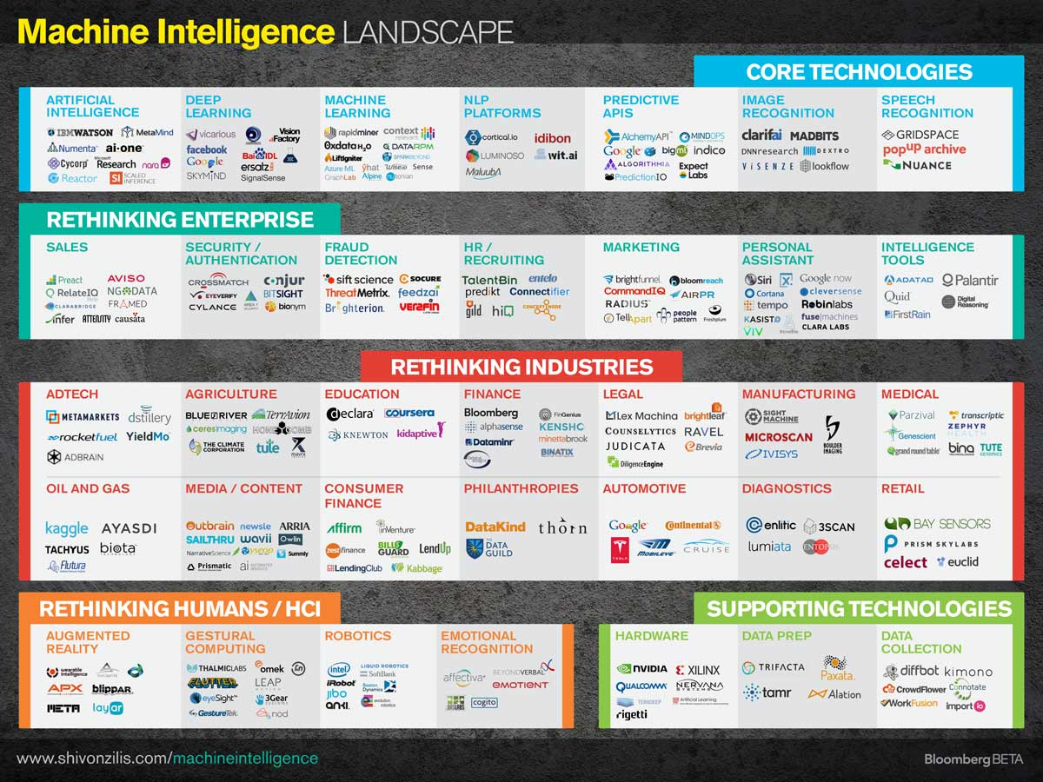

Slide 11
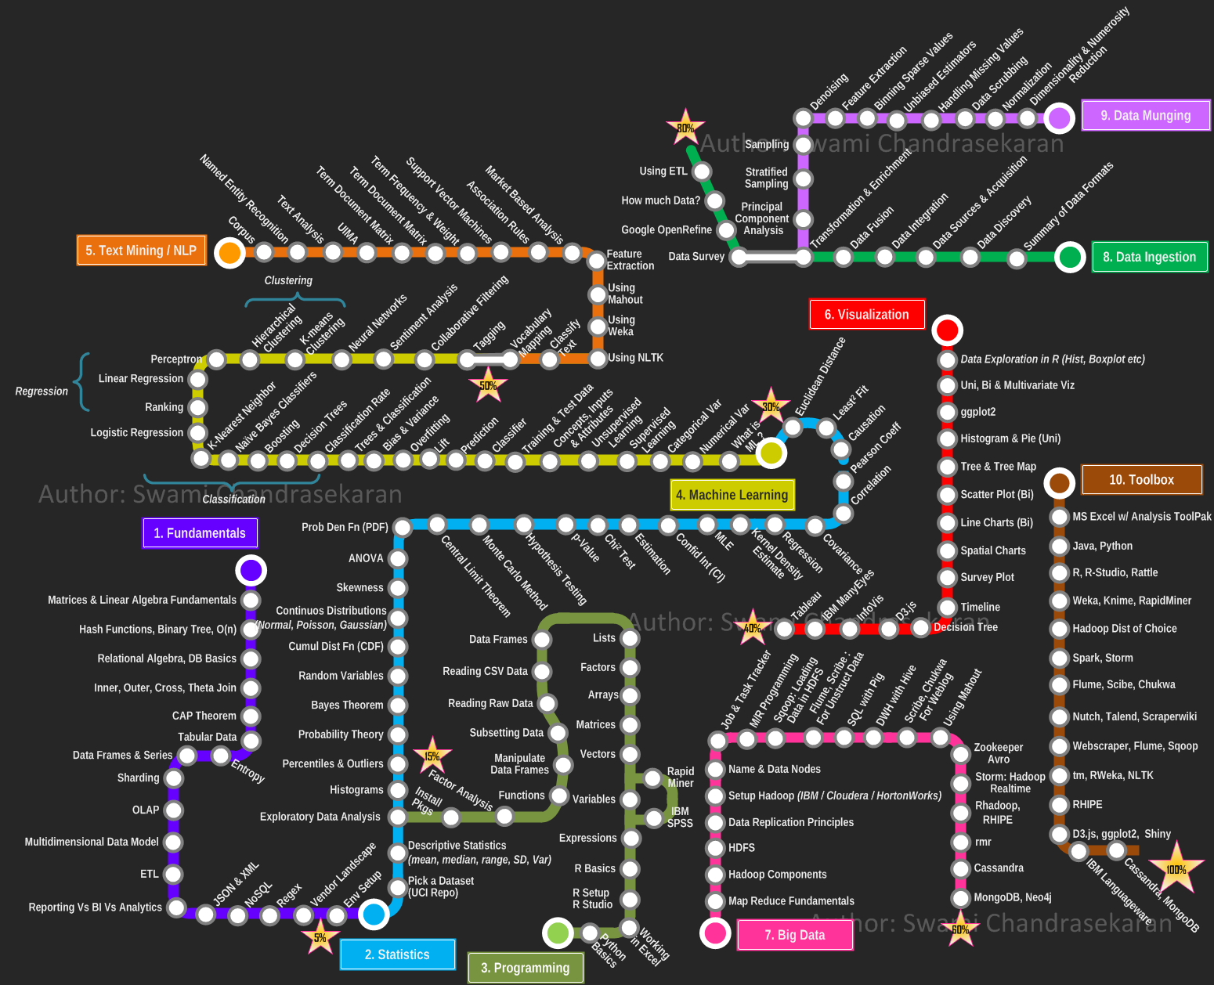

Slide 12


Slide 13
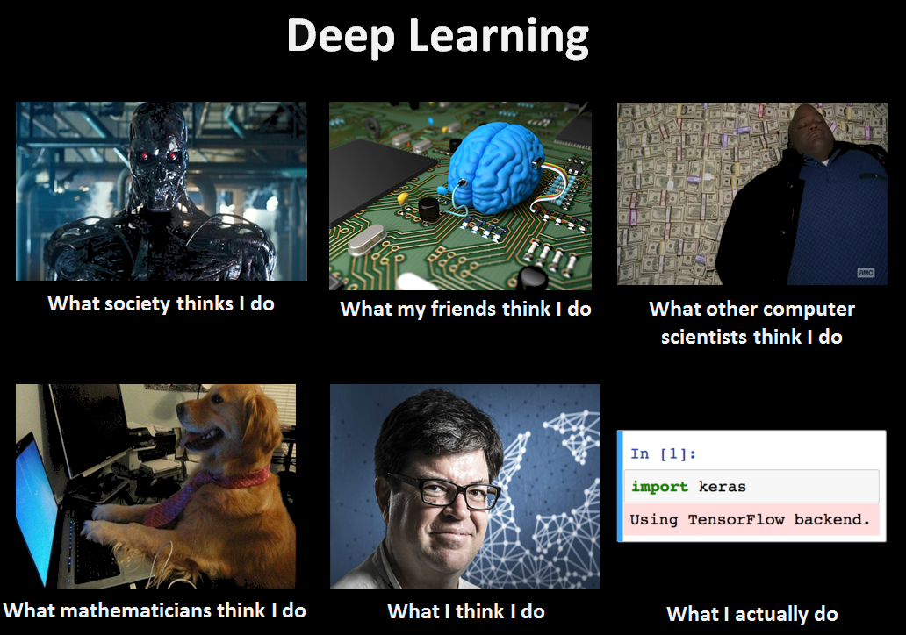

Slide 14
Required Software
Python
Pip
TensorFlow NumPy Jupyter Matplotlib
Notepad++
ConEmu
Optional: VS Code or PyCharm

Slide 15
Required Software
Python : https://www.python.org/downloads/release/python-362/
Add python path to PATH environment variable
Pip https://bootstrap.pypa.io/get-pip.py
Python get_pip.py
pip install TensorFlow
Pip install NumPy
Pip install Jupyter
Pip install Matplotlib

Slide 16
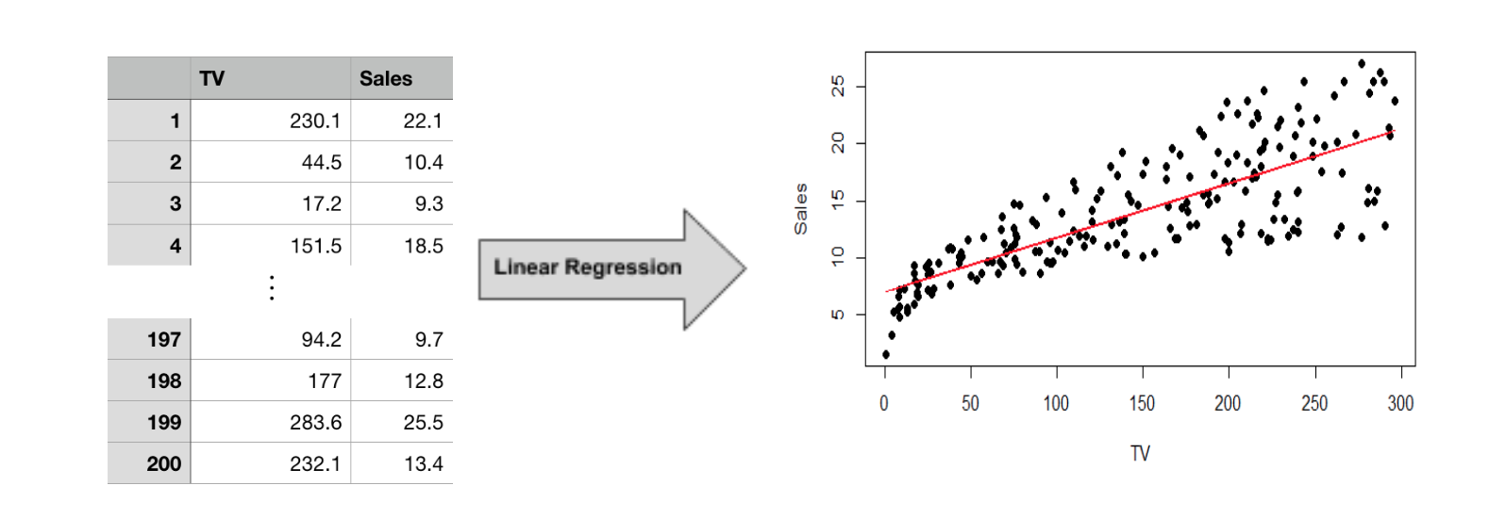
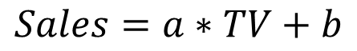
Linear Regression
$$Sales=a∗TV+b$$

